Slide 1
IMDb Data Exploration & Machine Learning
Katie Winkle, Katja Durrani & Vivienne Kuh
Women in Tech: Machine Learning Workshop Series

Slide 2
Introductions

Slide 3
What could we predict?
IMDb data set included a huge range of features covering film details, actors & directors, financials etc.
Each explored something different – Facebook likes, IMDb score & country of origin
Presenting back on trying to predict the number of Facebook likes a film might receive
Social media massively relevant to modern day marketing & advertising
Some measure of pervasiveness/pervasiveness and therefore success

Slide 4
Where to start? Pre-processing the Data
Many 0 like entries, some of which definitely incorrect (e.g. Pirates of the Caribbean?!) so deleted all; ~2k data entries!
Facebook likes is a continuous scalar – so need to discretise under pre-defined labels
Wanted to assign ‘Low – Medium – High’ labels based on relative number of likes (bottom 25% = low, top 25% = high)
Applying directly to Facebook likes didn’t work – ended up with too many films in the ‘medium’ category
Instead ranked films based on Facebook likes and applied labels based on those rankings

Slide 5
Ready for a first run Quantitative Only Full Feature Set KNN
Minimum data manipulation for building a KNN classifier:
NaN’s replaced with zeros
0 Facebook like data entries removed
Facebook like Low/Medium/High labels created
All qualitative data dismissed – KNN requires numbers!
Used sklearn to scale/split data and train KNN just as in class
Achieved a prediction accuracy of 54.8% on the training data

Slide 6
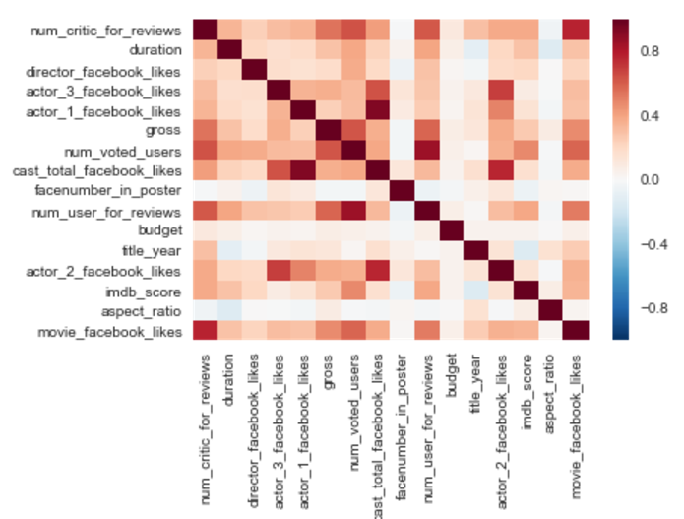
What’s really relevant? Data Exploration & Visualisation
Heatmap based on correlation matrix using pandas df.corr()
Picked out variables with correlation >= 0.5 (0.499 for gross)
Satisfying reflections:
Number of critic reviews strongest correlation
IMDb users like movies on Facebook?
Some correlation with gross
Not linked to actor/director Facebook likes
Improved KNN classifier with 60.4% accuracy

Slide 7
What about the text data we ignored? Data Exploration & Visualisation
Example: is genre relevant?
Pre-processing:
Multiple genres per film – treated as ‘tags’ rather than primary genre
Python scripting for splitting genre list in CSV, counting etc.
Satisfying reflections:
Documentaries rarely labelled as high, most Sci-Fi films medium/high – Facebook user demographics?

Slide 8
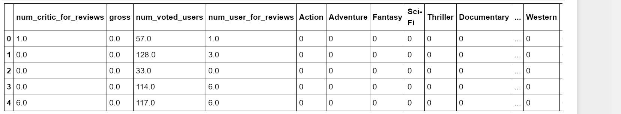
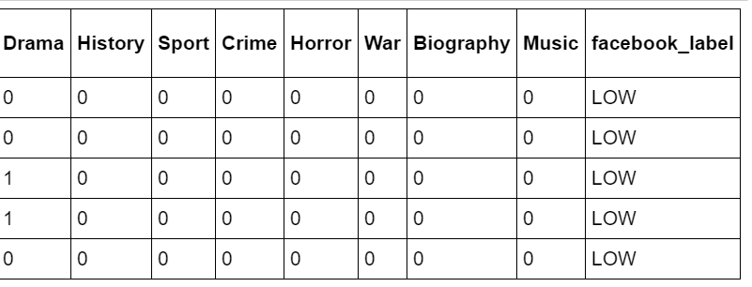
How to deal with text? Coding Qualitative Data
Example workaround for genres: binary classification
Does it have the action ‘tag’?
Not full solution (depends on number of possibilities e.g. language vs directors)
Addition of all genre data reduced classifier accuracy to 59.8%
Genres with one label >50% pushed accuracy up to 61.2%
Higher than what we achieved with the quantitative data alone

Slide 9
Did we miss anything? Further Data Pre-Processing
Took another look at selected features data set
Removed some missing entries for gross
Huge difference in scale of e.g. gross versus number of critic reviews, so normalised all data with respect to their maximum
Increased accuracy again to 65.7%
Realised gross in different currencies – removed
Increased accuracy again to final value of 67.9%

Slide 10
So can we predict Facebook likes? Final KNN & Reflections
Final data features used by classifier:
Number of critic reviews
Number of users who’ve voted
Number of users who’ve left reviews
Can predict Facebook like label (H-M-L) with accuracy of ~68%
Suggests IMDb user behaviour somewhat reflective of Facebook user behaviour
Overlapping demographics in IMDb & Facebook users
IMDb users are a good test case for predicting film popularity

Slide 11
How good really is it? Comparing to ‘Chance’
Pure classifier accuracy isn’t always enough
Breast cancer recurrence: always predicting no would be 70% accurate¹
In the Facebook like case, always guessing ‘Medium’ would be ~50% accurate
Initially caught us out, you would expect ‘chance’ to be 33% as 3 possible labels
¹http://machinelearningmastery.com/classification-accuracy-is-not-enough-more-performance-measures-you-can-use/

Slide 12
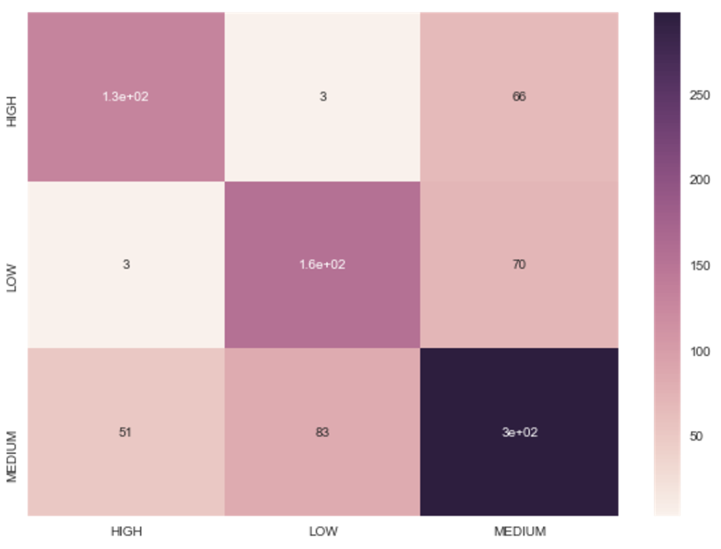
How else can we check? Confusion Matrix
Shows misclassifications by label
Reflections:
High & low rarely confused
Most often correct on medium films -> reflection of data set as discussed prev?

Slide 13
So what did we learn?
Importance of pre-processing of data (non-trivial)
Missing/incorrect entries
Qualitative data
Demonstrated accuracy improvement
Data exploration, understanding & feature selection is vital
Demonstrated accuracy improvement
Also allows for meaningful reflections at this stage
Understanding data spread important for then assessing predictor performance
Classification accuracy is not always the best performance indicator
Confusion matrix one example of an alternative

Slide 14
What would we ask next?
How else might we have pre-processed the data?
Clearly this can have big impact on predictor performance!
How else could we choose which features to train on?
Features analysis methods
How else could we deal with qualitative data?
Other algorithms as well as coding methods
What other learning algorithms might be better suited to this task?
How might our reflections be useful in a business context?

